Slide 1

IMAGE COMPRESSION
Discrete Cosine Transform
BY: Group 31
Hemanth Kumar J
Pradeeshwar J
Dometti Sree Gnanesh
Yacha Venkata Rakesh
Deepak Abhiram Inagandle
Ref: https://www.math.cuhk.edu.hk/~lmlui/dct.pdf

Slide 2
IMAGE COMPRESSION
Reduces Amount of data required to store an image.
Useful when storing or transmitting data.
Measured by compression ratio - Ratio of space needed to store after and before compression.
Lossy compression provides higher compression ratio by sacrificing negligible data. Uses: Photography images can be converted to JPEG and stored thus occupying less space.
Lossless compression on image has very less compression ratio but does not lose any data. Uses: Medical images need high precision in order to prevent any error.

Slide 3
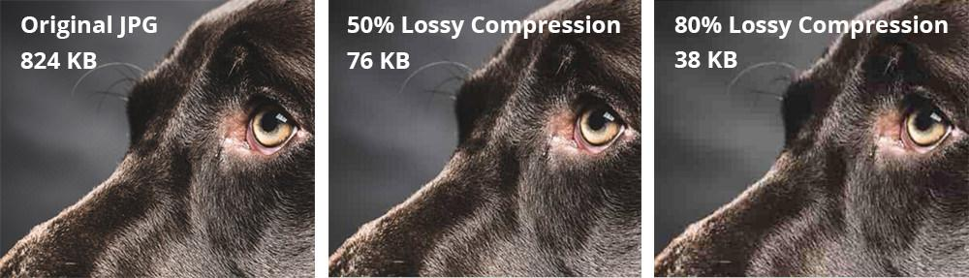
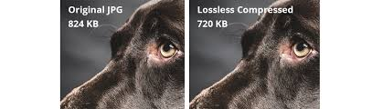

Slide 4
DISCRETE COSINE TRANSFORM
Algorithm used in most image compressions like JPEG.
Image is first broken into 8x8 block pixels.
From left to right, bottom to top, DCT is applied to each block.
Each block is compressed using quantization.
Array of compressed blocks is stored reducing storage space required.
Can be decompressed by using Inverse Discrete Cosine Transform(IDCT) whenever necessary.

Slide 5
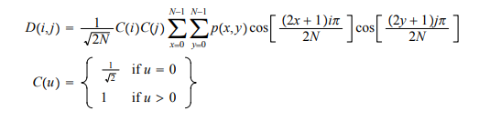
METHOD 1: EQUATION
We use 4 for loops to compute the required compressed matrix .
Since 8x8 matrix is usually used in JPEG, N = 8.

Slide 6
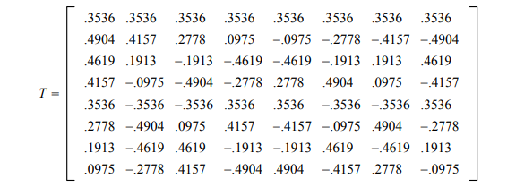
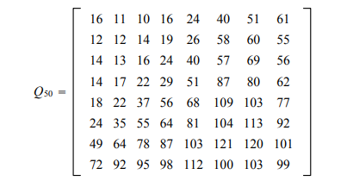
METHOD 2: MATRIX MANIPULATION
Constants used:
T , calculated for a specific DCT matrix.
Q50 , A quality matrix playing major role in maintaining the compression. The more the level of quality matrix, the more the compression.
Each element in the Image has from 0-255. Since DCT can be applied for -128 to 127 we subtract 128 on each element.

Slide 7
STEP 1: APPLYING DCT ON EACH 8X8 BLOCK
We find D matrix by:
D = T M T’
Where T is transpose of matrix T.

Slide 8

STEP 2: QUANTIZATION
We divide each element of the D matrix by each element in the Q matrix, acquiring ‘C’.
We then round off each of the floating point numbers in C to get integer values.
Note that most of the lower triangle of the matrix becomes 0.

Slide 9
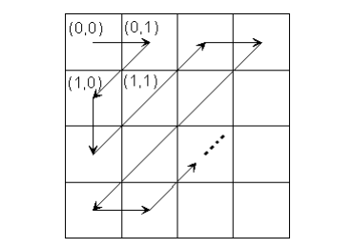
STEP 3: CODING
We then take 16(as it has a good data retaining - compression ratio) values in the following order and convert it into a 1D matrix.

Slide 10
DECOMPRESSION
We retrace the methods we used:
Decode the 1D matrix to get the 2D matrix according to the figure in the previous slide and fill the rest with zeroes.
Multiply element-wise with Quality matrix(let the output here be R)
Apply N = T’ R T.
We round off N and add 128 .
Thus we obtain the original image with negligible data loss

